Slide 1
SDN-BASED
DYNAMIC ROUTING
AND FIREWALL
Final Year Project Presentation
Group Members
Muhammad Sami G1F22UBSCS248
Muhammad Riaz Arham G1F22UBSCS117
Hamza Asghar G1F22UBSCS119
Notes:
Opening: Assalam-o-Alaikum. My name is Muhammad Sami, and with my team members Muhammad Riaz Arham and Hamza Asghar, we will present our final year project, SDN-Based Dynamic Routing and Firewall.

Slide 2
Research-Based Project
SDN-Based Dynamic Routing and Firewall
Investigated the use of Software Defined Networking (SDN).
Compare traditional network management with centralized SDN control
Study dynamic routing, VLAN segmentation, and security policy management
Evaluate the approach through a simulated multi-campus university network
Implementation & Evaluation
Mininet — Network Simulation
Open vSwitch — SDN Switches
OpenFlow Protocol
Ryu — Centralized SDN Controller
Dashboard — Network Monitoring & Policy Management
A simulated multi-campus university network that uses SDN to centralize routing, security policy, and monitoring.
Notes:
Introduce yourself and teammates, then state the project in one sentence. Do not read every word on the slide.

Slide 3
What is Software Defined Networking (SDN)?
Applications
SDN Controller
Network Switches
CONTROL / DECISION
DATA / FORWARDING
Traditional network
SDN network
Each switch / router contains its own control logic.
The network is configured device by device.
The controller makes the network-wide decision.
Switches execute the rules installed by the controller.
“The controller decides. The switches forward.”
Notes:
Explain SDN in one sentence first. Then point to the controller and switch roles. This gives the audience the mental model needed for the rest of the presentation.

Slide 4
Real-World SDN Deployments
Stanford University — CIS Building
Internet2 / university research networks
Other research and campus network environments
Deployment Scale
6 production OpenFlow switches
SDN controller
30 OpenFlow-capable Wi-Fi access points
Physical production network
Source: Kobayashi et al., Maturing of OpenFlow and Software-defined Networking through deployments

Slide 5
Benefits
Centralized Management
Faster Configuration
Multi-Vendor Support
Programmability
Better Visibility
Network Virtualization
Limitations / Challenges
Switch CPU and flow-table limitations
Legacy network integration issues
STP and OpenFlow interaction
Production stability and reliability challenges
Extensive testing and debugging required

Slide 6
Problem Statement
Suppose Student WiFi must be blocked from reaching an Administration server. The policy must be enforced across the campus path—not only at one user PC.
Problem 1 — Distributed control
Problem 2 — Policy complexity
Problem 3 — Visibility
The administrator works across separate switches, routers and security devices.
A small access-policy change can require multiple device updates and verification.
Failures and traffic behavior are harder to view from one place.
Notes:
Engage the audience here. Ask the question before revealing SDN. Let the supervisor respond briefly, then say: “This is exactly the management problem our project addresses.”

Slide 7
Muhammad Riaz Arham G1F22UBSCS117

Slide 8
What Problems Does the Traditional Model Create?
Manual configuration
Configuration risk
Slow policy changes
Limited central visibility
Policies are changed device by device.
More devices mean more opportunities for mismatch or human error.
Security or routing changes take more steps to apply and verify.
Topology, traffic, logs and failures are not naturally managed from one control point.
So what changes with SDN?
Move the network-wide decision logic into a controller and let the switches execute the resulting flow rules.
Notes:
Keep this slide fast. It summarizes the problem immediately before introducing the SDN solution.

Slide 9
How the Same University Network Works with SDN
Applications / Dashboard
Ryu SDN
Controller
OpenFlow
Switches
1. Detect / learn
2. Decide
3. Install rules
Example: Student → Server
Controller logic
Switch behavior
Controller checks VLANs + ACL policy.
If allowed, it calculates the path.
If blocked, it installs a drop rule.
Learns hosts, maintains topology, checks policies, selects a route, and installs OpenFlow rules.
Open vSwitch forwards packets using the rules already installed by the controller.
Result: network decisions become centralized and programmable.
Notes:
Explain the three-step workflow. This is the main conceptual bridge from “problem” to “our project.”

Slide 10
Traditional Network vs SDN
Aspect
Traditional
SDN
Decision logic
Distributed across network devices
Centralized in SDN controller
Policy change
Configure devices individually
Update policy at one control point
Routing
Configured on routers / L3 devices
Controller calculates forwarding path
Security
Rules spread across devices
Central policy / ACL / firewall logic
Visibility
Tool-dependent and distributed
Dashboard + controller state
Failure response
Depends on configured device behavior
Controller can detect topology change and react
Notes:
Do not read every table row. Highlight the three strongest differences: centralized decisions, one-point policy control, and controller-based visibility.

Slide 11
Our Solution: SDN-Based Dynamic Routing and Firewall
A simulated multi-campus university network
Mininet
Virtual Network
Open vSwitch
Data Plane
Ryu
Controller
Web
Dashboard
Campus model
2 Campuses
8 Switches
20 Hosts
8 VLANs
Main Campus
City Campus
Control & Security
Core + Admin + Academic + Lab + Library / DC
Core + City Admin / Lab + Student WiFi
Routing + ACL/firewall + monitoring + alerts
Notes:
State the exact scope from the project documentation: simulation-based multi-campus network using Mininet, Open vSwitch and Ryu.

Slide 12
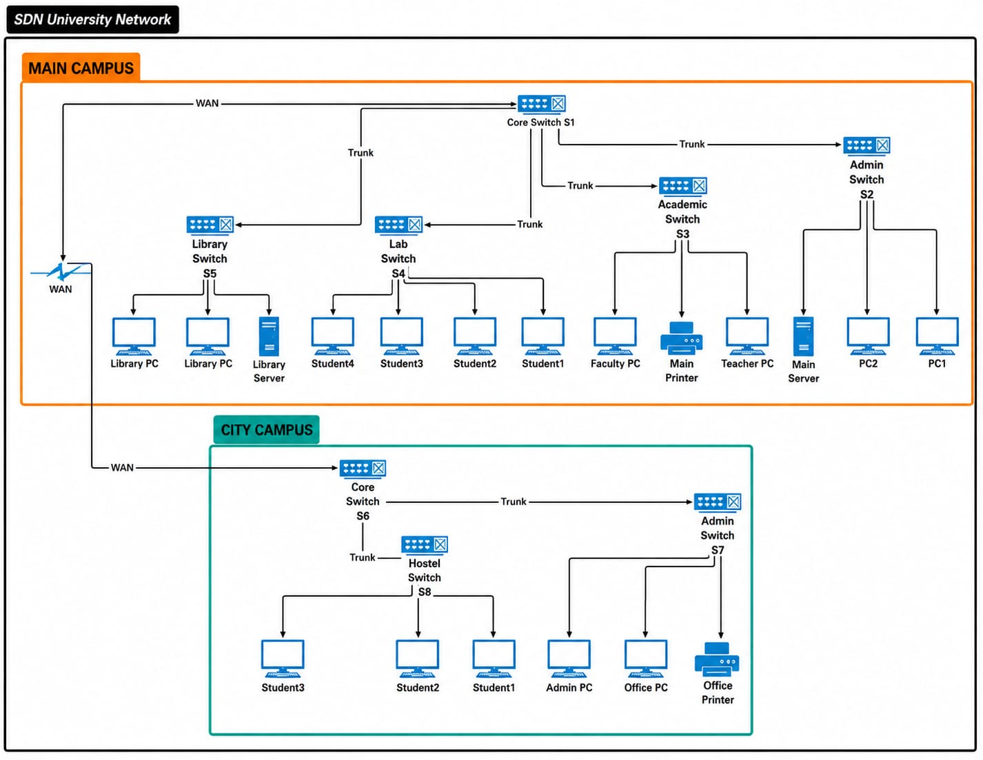
Our University SDN Topology

Slide 13
How We Separate the University Network: VLANs
V10
Main Admin
V20
Faculty & Staff
V30
Teaching Labs
V40
Student WiFi
10.0.10.0/24
10.0.20.0/24
10.0.30.0/24
10.0.40.0/24
V50
Library & Servers
V60
City Admin
V70
City Labs
V80
City Student WiFi
10.0.50.0/24
10.0.60.0/24
10.0.70.0/24
10.0.80.0/24
Why VLANs?
Why IP subnets?
Why policies?
Separate broadcast domains and apply different access policies.
The controller can identify source and destination networks.
Not every department should automatically reach every other department.
Notes:
Do not read all VLAN names. Give 3–4 examples, then explain that the controller uses the VLAN and IP information to make routing and policy decisions.

Slide 14
Hamza Asghar G1F22UBSCS117

Slide 15
What Happens When a Packet Arrives?
Controller workflow used in our project
1
Receive packet
2
Identify
3
Check policy
Switch sends packet information to controller when a decision is needed.
Learn source host, input switch/port and VLAN.
For inter-VLAN traffic, consult the ACL / firewall rules.
4
Choose path
5
Install rules
6
Forward / drop
Calculate the route through the topology graph.
Push OpenFlow rules to switches along the selected path.
Allowed traffic is forwarded; blocked traffic is dropped and logged.
This is the “dynamic” part of our project: the route and policy decision are made from current network state and rules.
Notes:
Walk through the six steps once. This is where the project becomes technically concrete.

Slide 16
Project Functionalities
VLAN segmentation
Inter-VLAN routing
ACL / firewall
Dynamic routing
Separate departments and user groups
Allow traffic between VLANs when policy permits
Allow or block VLAN pairs and TCP/UDP ports
Calculate a path from the topology graph
Dashboard monitoring
Event logging
Link failure alerts
Runtime policy changes
View switches, VLANs, statistics and policies
Record forwarding, dropping and policy events
Detect failed links and notify the administrator
Update security rules without editing controller code
The project documentation marks these core modules as completed and tested in the Mininet simulation environment.
Notes:
Mention only the functions you can demonstrate. The documentation records VLANs, inter-VLAN routing, ACL/firewall, dashboard monitoring, event logging and link failure alerts as completed.

Slide 17
Example: ACL + Firewall
Student WiFi
VLAN 40
Ryu Controller
Admin Server
VLAN 10
ACL decision
BLOCK VLAN 40 → VLAN 10
Blocked traffic
Logged event
Packet is dropped according to policy.
The event can be shown in the dashboard / logs.
The project also supports TCP/UDP port blocking through firewall rules.
Notes:
This is a strong example to explain the firewall feature. The documentation specifically records VLAN allow/block policy and TCP/UDP port blocking.

Slide 18
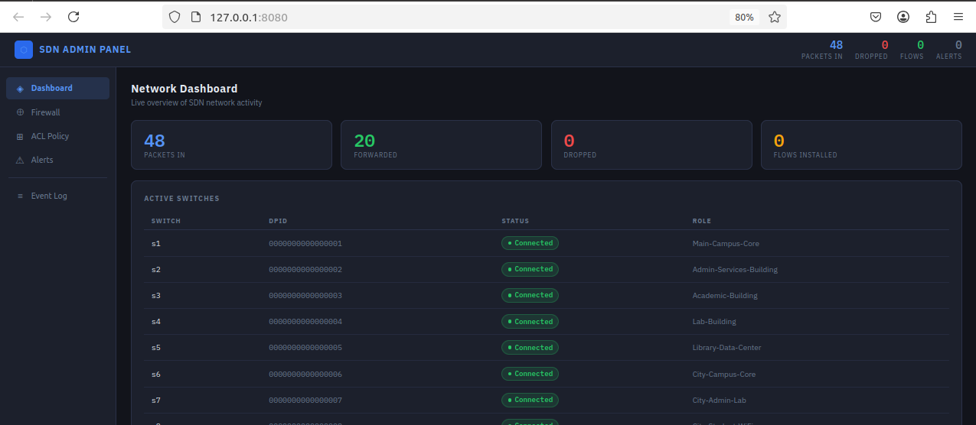
Web Dashboard: One Place to See and Manage the Network
Notes:
This slide is deliberately visual: explain that the dashboard turns controller state into a single management view.

Slide 19
Link Failure Handling
Switch A
Switch B
Switch C
Destination
LINK DOWN
1. Detect
2. Update
3. Recalculate
Controller receives the topology-change event.
Failed link is removed from the topology graph.
New traffic can use an alternate route when one exists.
Our documented result: link failure alerts are generated; route recalculation is supported when an alternate path exists.
Notes:
Be precise: your documentation says route recalculation is partially completed because it works when an alternate path exists. Do not claim automatic recovery when no alternate path exists.

Slide 20
Conclusion
Traditional approach
SDN approach
Our prototype
Works, but control is distributed across devices and policy changes are more manual.
Centralizes network decisions, policy logic, topology awareness and management.
Demonstrates routing, VLANs, ACL/firewall, monitoring, logging and link alerts.
SDN does not replace the network.
It changes where the network intelligence lives.
Notes:
Close with the one sentence. Then invite questions.

